Slide 1
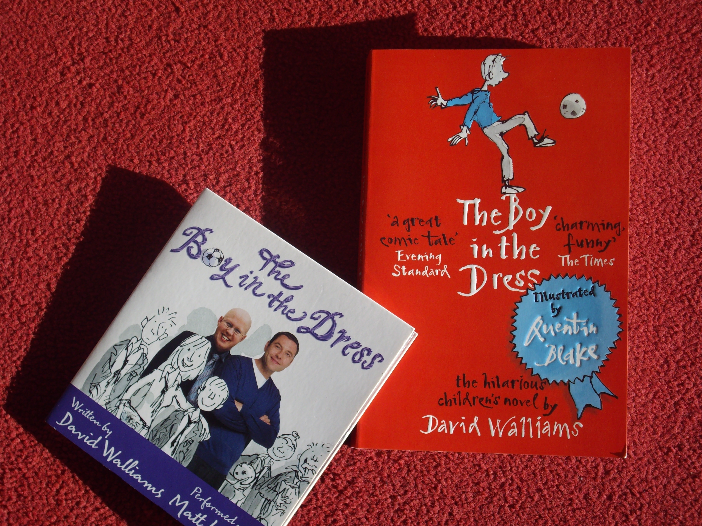
The Boy in the Dress
by
David Walliams

Slide 2
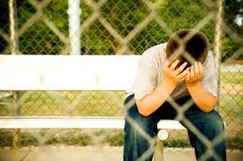
No Hugging
Divorce and how it affects people-
especially missing mum

Slide 3
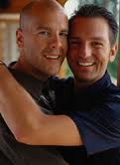
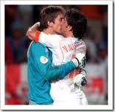
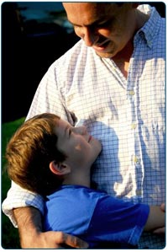
Fat Dad
Hugs and physical contact-
when is it right and with whom?

Slide 4
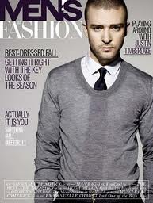
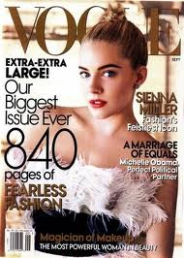
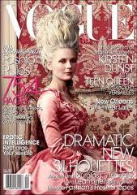
Under the Mattress
Magazines….for boys!?

Slide 5
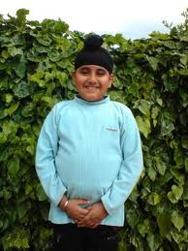
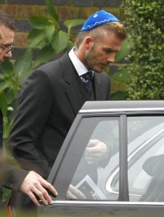
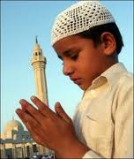
Wanting to Disappear
Being visibly different- Darvesh’s Patka

Slide 6
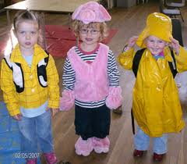
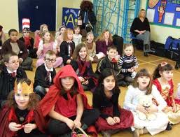
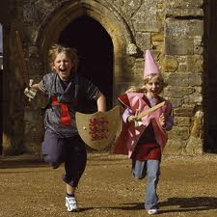
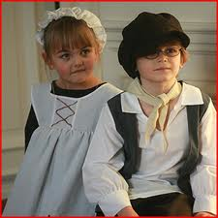
Forever and a Moment
Dressing up - When did you last play?

Slide 7
Lying on the Carpet with Lisa
“Rules don’t apply here you can be whoever you want to be…”
Who would you like to be?

Slide 8
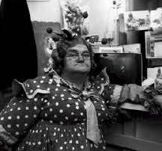
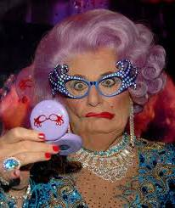
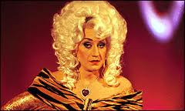
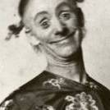
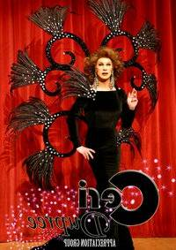
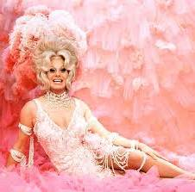
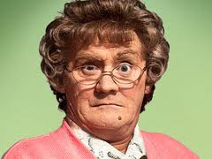
Bonjour, Denise
British entertainment has always been populated with men in dresses- Panto dames, drag artistes & TV celebs…

Slide 9
Double French
Was it OK for Dennis to upset Miss Windsor by insulting her French accent..?

Slide 10
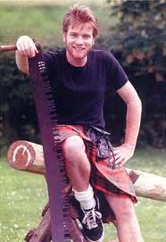
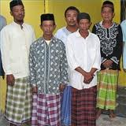
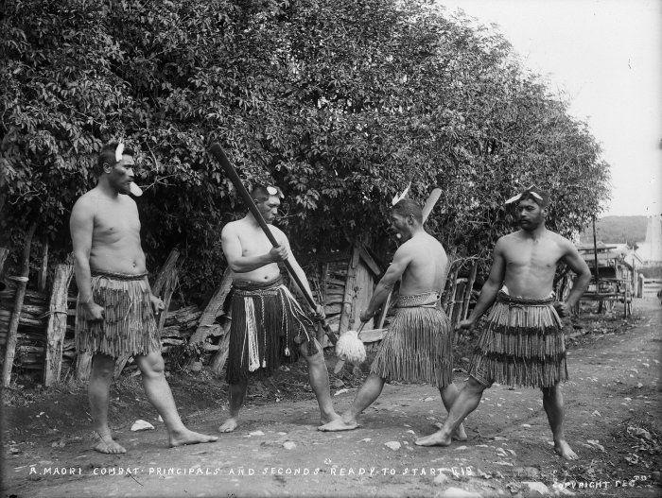
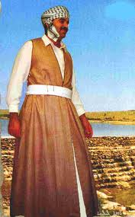
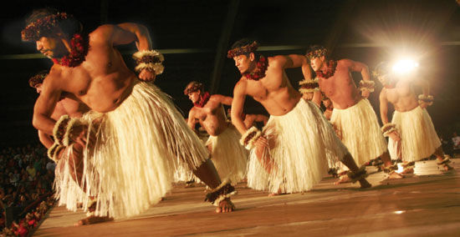
Silence like Snow
The Head’s reaction to Dennis wearing a dress to school is to expel him… is this right? Many men around the world do not wear trousers…

Slide 11
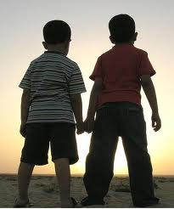
There was Nothing More to Say
Despite what has happened Darvesh remains a ‘true friend’… What makes a true friend for you? List their qualities….

Slide 12
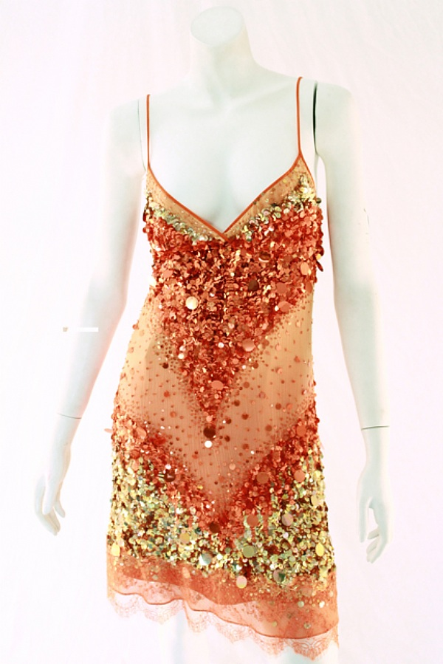
With or Without the Dress
Darvesh’s mum really surprises us with her reaction…
“orange is not
really your
colour Dennis”

Slide 13
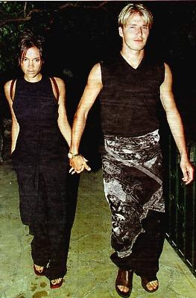
A Thousand Smiles
Lisa gets all the lads in the team to dress up. Here is another footballer who has decided to
wear a sarong… why?
Does wearing a dress make a boy gay? Does an interest in fashion?

Slide 14
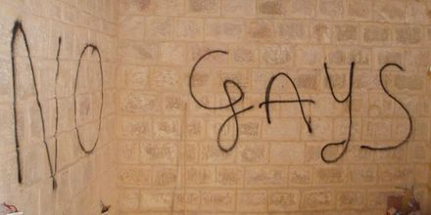
Dragged in the Mud
The Maudlin Street team are angry at losing and resort to bullying and homophobic name calling, such as “woofters”. Is this right or wrong? What insults have you heard that you dislike? Why?

Slide 15
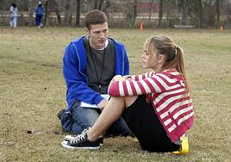
Blouse and Skirt
Dennis is unable to tell Lisa that he likes/loves her… sometimes it’s hard to say the things you feel – why?

Slide 16
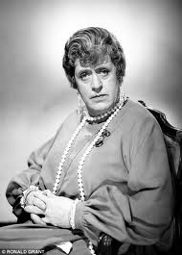
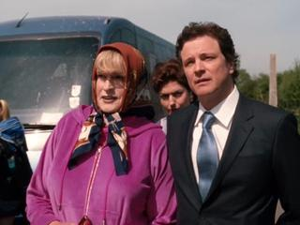
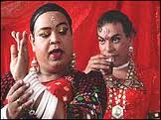
20 & 21 – Big Hairy Hands
St. Trinians School Head teacher
has always been played by a man
in drag.
There is also a sprinkling
of drag in Indian
(Bollywood) films.

Slide 17
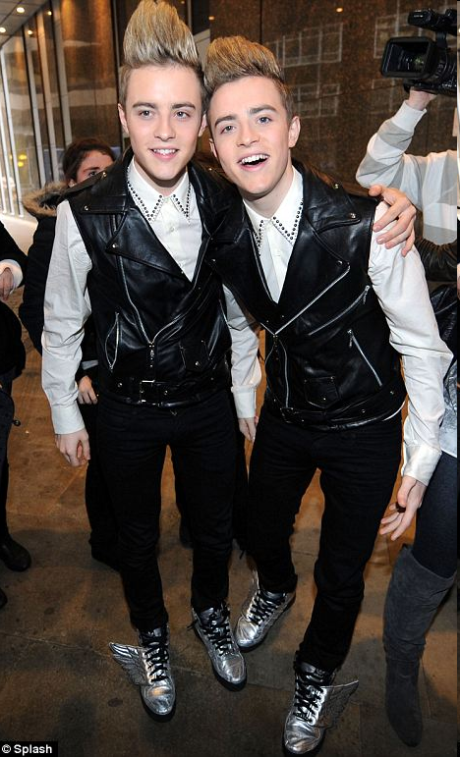
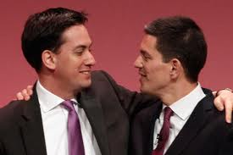
22 One Thing Left to Do
Interestingly Dennis is asked to play Joan of Arc in the school play - a woman who took on a man’s role in history…
But most importantly Dennis and John, his brother, hug – displaying brotherly love.

